Slide 1
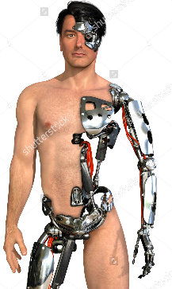
Ethical considerations of emerging technologies
Genetic technologies
Implantable devices
17.6.3 Provide examples of ethical considerations of emerging
technologies.
Unit C 17.6 Trends in Medical Research Ethics
Module 279-17-C Regulations, Standards and Ethics
dr. Chris R. Mol, BME, NORTEC, 2016

Slide 2
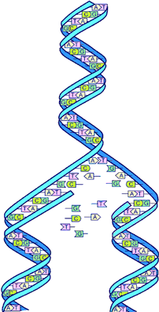
The human Genome
In 2003, for the first time the genome of a human being was ‘mapped’. The human genome consists of about 30,000 genes, which each consist of 3 billion nucleotides, of which we have four different versions (A, T, G, C).
The genes are divided over 23 pairs of chromosomes
Nucleotides can be regarded as the four letters in the ‘genetic’ alphabet. The genome can be regarded as the recipe/blueprint for a human being.
The fact that we have mapped the genome means that we know the ‘sequence of letters’. We now can ‘read’ the recipe but we don’t know what the letters and words mean…..
This is what many research institutions are working on.
©
Ethics in Emerging Technologies
dr. Chris R. Mol, BME, NORTEC, 2016

Slide 3
Genetic Testing
A person’s inherited characteristics, such as sex, skin color, eye color, hair type, length, shoe size, etc. etc. are all written somewhere in his/her genome, his/her human recipe.
Also genetic diseases are recorded in this recipe, even if the human carrier does not show symptoms of the disease. For example: Sickle cell anemia, Huntington’s disease, Tay-Sachs disease.
If we would know what characteristics are written at what location in the genome, and we could read this, we would know potentially useful information.
For example, if we would find that a couple that wants to have children both have the genetic code for sickle cell anemia, we would know that the child will certainly have this disease. If only one of the parents had this code, we would know that a child would not have this disease.
What the couple would do with such info (choose to have no children?) is a next, ethical question, but generally it is thought useful to be able to have such info and this is an incentive to pursue such research.
©
Ethics in Emerging Technologies
dr. Chris R. Mol, BME, NORTEC, 2016

Slide 4
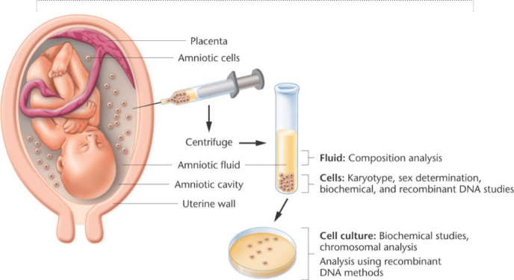
Pre-natal genetic diagnosis
Genetic technologies are available to check genetic aspects of a fetus still in the womb. For example, in amniocentesis, some fluid is taken from the uterus (14-16 weeks into pregnancy) and analyzed. Some very serious diseases, including Down’s syndrome and sickle cell anemia can be detected in this manner. This is currently done in Western countries on high-risk pregnancies (>35 year old mothers with a family history of disease, etc. )
An ethical question is what you are going to do with this info. Abortion, or putting a child in the world that will suffer a lot, die early and may not have a full human existence (if that can be defined)?
And what is this choice if you could have such info after 1 or 2 weeks into the pregnancy ?
©
Ethics in Emerging Technologies
dr. Chris R. Mol, BME, NORTEC, 2016

Slide 5
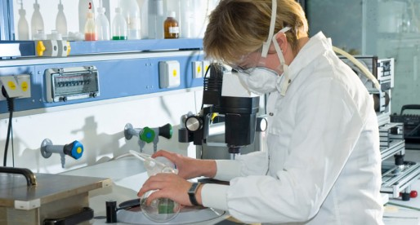
Pre-symptomatic Testing
Suppose a person can be tested for genetic diseases before the symptoms appear. Such testing may be especially appropriate in families that suffer from by a particular genetic disease that can be averted if proper measures are taken.
For example, some disease can be managed successfully by having a diet, or by doing some preventive surgery.
Sounds good, doesn’t it ?
But would you want to know that you are likely to get a disease if you could not do anything about it ?
©
Ethics in Emerging Technologies
dr. Chris R. Mol, BME, NORTEC, 2016

Slide 6
Genetic testing and Privacy
Do other people have a right to know your genetic make-up / problems ?
If you have a serious (genetic) disease, is your future partner entitled to know this?
Is your life insurance company entitled to know, or your employer?
If your medical doctor knows you have a genetic disease, are there circumstances that (s)he should tell this to other people (e.g. your brother or sister who may have the same disease…)?
Does a person have a right not to know?
If you would know that you have a disease, you could prevent others from inheriting this. Is there a moral duty to find out? Is it irresponsible not to want to know?
Do we want pilots in our airplanes/busses who have a disease which can endanger the flight/ride? (individual freedom versus social control)
©
Ethics in Emerging Technologies
dr. Chris R. Mol, BME, NORTEC, 2016

Slide 7
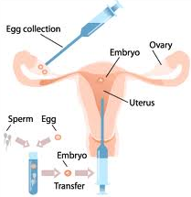
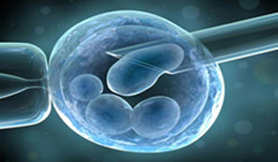
Eugenetics Issues (‘Eu’ = good (in Greek))
Human fertilization can be accomplished In Vitro. This leads to a ‘Test Tube baby’. Per Feb. 2016, this has been done 5 million times worldwide. This is e.g. done when the couple has difficulty in getting children e.g. because the male semen is not very fertile.
In this procedure, a number of female eggs are removed from the ovaries and kept alive in the laboratory. This is combined with selected male semen, leading to (in vitro) fertilization. After some growth in a test tube environment, the fetal cells (embryo) are implanted in the female uterus, leading to a normal child birth.
Suppose that one can select the best possible sperm in the semen. Is that ethically ok ?
The most healthy, intelligent, most beautiful,…. child ?
©
Ethics in Emerging Technologies
dr. Chris R. Mol, BME, NORTEC, 2016

Slide 8
Genetic Engineering
So far, this presentation was restricted to observing a genetic disease or selecting a certain sperm/egg combination. Now what about modifying genomes ?
Genetic engineering is the direct manipulation of an organism's genome using biotechnology. New DNA may be inserted in the host genome and/or genes may be removed, or "knocked out“.
Genetic engineering in plants
The first field trials of genetically engineered plants occurred in tobacco plants which were engineered to be resistant to herbicides (1986). The first commercial product was a tomato engineered to have a longer shelf life (1994). Genetically modified maize has been engineered to be more pest and herbicide resistant. GM maize has caused controversy with respect to possible health effects, impact on other insects and impact on other plants.
In 1994, the European Union approved tobacco, engineered to be resistant to a herbicide: the first genetically engineered crop commercialized in Europe. In 2009, 11 genetically engineered crops were grown commercially in 25 countries, including USA, Brazil, Argentina, India, Canada, China and South Africa. In general, these crops produce a bigger harvest per area.
©
Ethics in Emerging Technologies
dr. Chris R. Mol, BME, NORTEC, 2016

Slide 9
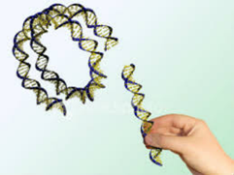
Genetic Engineering
What, if we could genetically engineer animals and plants ?
Is this too risky and/or ‘playing God’? Should it be forbidden? (and could we stop other societies from experimenting?)
Or is it a faster way of ‘natural’ evolution, such as in selective breeding which has been done for many plants and animals?
E.g. it is not ‘natural evolution’ that has created cows that give so much milk. Dairy cow milk yield has increased from an average of 12 litres/day/per cow 50 years ago to 24.5 litres/day/per cow today.
The genetic engineering is done here by selecting the best cows and bulls for breeding….
And what, if we could genetically engineer humans ?
©
Ethics in Emerging Technologies
dr. Chris R. Mol, BME, NORTEC, 2016

Slide 10
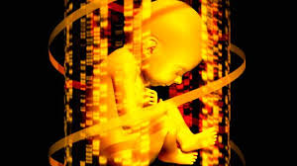
Genetic Engineering in humans
Most of these questions have no black and white answer for many people and cultures. There are too many situations and details.
It feels good to make sure that our children do not have genetic diseases.
It does mostly not feel good to try and select all sorts of human qualities. This generates many new ethical issues such as the social and economic divide between the genetic haves and have-nots, the risk of ‘creating monsters’, etc.
We will be playing with fire !
“The benefits are probably worth the risks, but proceeding judiciously is still in order” (Rosemary Tong, 2007)
©
Ethics in Emerging Technologies
dr. Chris R. Mol, BME, NORTEC, 2016

Slide 11
Implantable devices
Implantable devices have a long history in medicine with artificial hips being implanted since 1925, pacemakers since 1957, heart valves since 1961, artificial hearts since 1982, etc.
In April 2004 approval was given for a clinical trial in which chips will be placed in the brains of paralysed patients. The goal is to use signals from the brain to control a wheelchair or other assistive technology, and ultimately to move muscles and limbs. In October 2004 it was reported that a brain chip had been successfully implanted into the motor cortex of a 24-year-old quadriplegic (with paralysis of all four limbs and torso) patient. He is reportedly able to control his television while talking and moving his head….
Implant ethics is the study of ethical aspects of the lasting introduction of technological devices into the human body.
©
Ethics in Emerging Technologies
dr. Chris R. Mol, BME, NORTEC, 2016

Slide 12
Ethical Issues with Implantable devices
Issues regarding Implantation are somewhat different from Transplantation issues….
We will discuss some of these issues in the next slides.
http://www.ncbi.nlm.nih.gov/pmc/articles/PMC1734218/pdf/v031p00519.pdf
©
Ethics in Emerging Technologies
dr. Chris R. Mol, BME, NORTEC, 2016

Slide 13
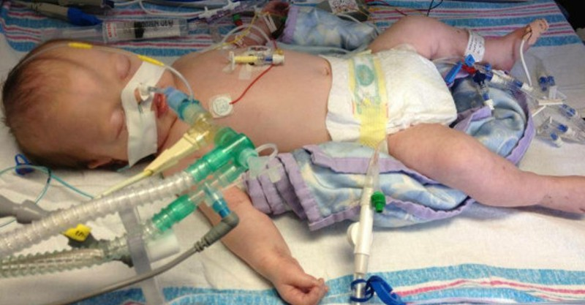
End of Life Decisions
Should one turn off a pacemaker at the request of a patient who is having recurrent disabling heart failure? Who has the right to turn off the device? Does the doctor have the right to turn it off, against the patient's wishes? Does the patient have the right to turn it off, against the doctor's wishes, and if so, for what reasons?
In semi‐implanted devices like an intra‐aortic balloon pump or a ventilator, the doctor has the right to turn off the supportive therapy by commission on grounds of futility. The patient also has the right to refuse the device on grounds of autonomy.
In fully implanted devices like a renal transplant, neither the doctor nor the patient have the right to have the kidney removed.
©
Ethics in Emerging Technologies
dr. Chris R. Mol, BME, NORTEC, 2016

Slide 14
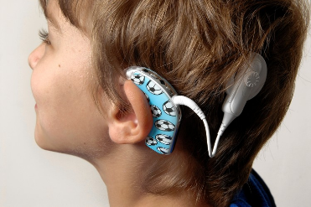
Disease concepts and Enhancements
If it becomes possible to improve a healthy person’s physical strength or memory to levels above his or her natural endowment, to what extent is it advisable to do so?
Related to implants, the enhancement discussion is anticipatory because no enhancing treatment is currently available. However, there are other branches of medicine that already deal with body enhancement namely cosmetic surgery (e.g. breast implants) and drugs.
Some drugs have the ability to improve normal functioning.
Certain drugs are used in the armed forces as wakefulness agents.
Drugs developed for depression are used for mood elevation by people with no psychiatric diagnosis
Drugs for erectile dysfunction are used for pleasure.
…
We already endorse improvements of the immune system via vaccinations.
Possibly, the best way to tackle issues of enhancement is to deal with them incrementally,
judging each case on the basis of our current values ….
©
Ethics in Emerging Technologies
dr. Chris R. Mol, BME, NORTEC, 2016

Slide 15
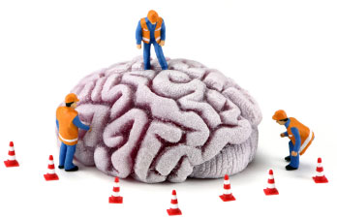
Mental change
Many types of treatment change a person’s personality, as certainly do many diseases. Successful treatments often reverse personality changes caused by the disease. As an example of this, the motor symptoms in patients with Parkinson’s disease often have a large impact on their personalities. Treatment can in part reverse these effects.
Personality changes and possible loss of personal identity can follow from the introduction of foreign (biological or technical) material into the brain, but also from natural causes such as tumours and from the surgical removal of brain tissue.
It has been hypothesised that computer–brain connections will allow computerised communication with other similarly connected individuals in a way that may require a reassessment of the boundaries between self and community. To the extent that this should happen, the consequences for society would be major.
However, currently we do not know if or how such a change could come about.
©
Ethics in Emerging Technologies
dr. Chris R. Mol, BME, NORTEC, 2016

Slide 16
Cultural Effects
Medical technology, including implants, has effects not only on individuals but also on social groups and on society as a whole. Radical improvements in treatment will change the situation of disabled groups in our societies.
Enhancement may lead to effects on our cultures and society. For example, it may be so that persons who have received certain enhancing interventions may form new subcultures. For example people with enhanced cognitive capacity or extended wakefulness may form separate groups.
Also, enhancement may change our views of normality, so that some unenhanced people may come to be seen as ‘‘subnormal’’ in the relevant respect. If some submit to enhancement, others may feel a pressure to follow suit for the same reason that bodybuilders who use steroids induce others to do the same.
Although implants resulting in enhancement are not part of today’s clinical reality, they are a realistic future option for which we should be ethically prepared.
©
Ethics in Emerging Technologies
dr. Chris R. Mol, BME, NORTEC, 2016

Slide 17
END
The creation of this presentation was supported by a grant from THET:
see https://www.thet.org/

